Slide 1
Lecture 18
18.1 What are Cities for? The Challenges Ahead
IUS Ch 10
©Luís M. A. Bettencourt 2023
Notes:
This is our last lecture, and a bit of a victory lap. I want to spend sometime discussing what we have learned about the essence of cities and some of the main challenges ahead.

Slide 2
The chief function of the City is to convert
power into form,
energy into culture,
dead matter into the living symbols of art,
biological reproduction into social creativity.
- Lewis Mumford, The city in history, 1962
https://en.wikipedia.org/wiki/The_City_in_History
Notes:
This quote is somewhat philosophical (if you don’t know Mumford, go find out) : he was all the rage in the 1960s-70s, but did not like many aspects of modern cities.

Slide 3
Recurring Themes in Urban Science
IUS 10.1
Cost-Benefit Dynamics
Connectivity
Information
dynamical, heterogeneous, noisy
poverty as disconnection
prosperity as connections
structural
growth rates
(social+human capital)
individuals, households, governments
barriers to connectivity = segregation, poverty traps, slums
choice
agency
education
migration
professions
businesses
neighborhoods
selects people into situations of
opportunity or disadvantage
volatility challenges
and the need for
clear horizons and growth
Disconnected/segregated individuals penalized
but also the system as a whole
because of network effects
The patterns of our lives (life paths):
the shape of connectivity, cost-benefit
over time
Notes:
I propose that you remember at least these three themes about cities, which allow you to generate most of their properties and dynamics.

Slide 4
Paying the high costs of connectivity in larger cities
is only worth it in light of greater social productivity
from deeper divisions of knowledge and labor
the new knowledge and possibilities this process creates
This presents as a state of interaction density, diversity, heterogeneity, interdependence and complementarity
which embeds more information per capita and creates fast change
Large cities have little to offer that is material, information is most of what they do
most ‘expensive’, most difficult to create, most enduring.
Notes:
In a nutshell, this is what is happening in cities:

Slide 5
The Challenges Ahead
IUS 10.2
urban science must generalize to entirely new situations
Gigacities
The Challenge of Slums
Shrinking Cities
Sustainable Development
Notes:
Let’s now look ahead, and briefly discuss these challenges (you can include your own and think through it).

Slide 6
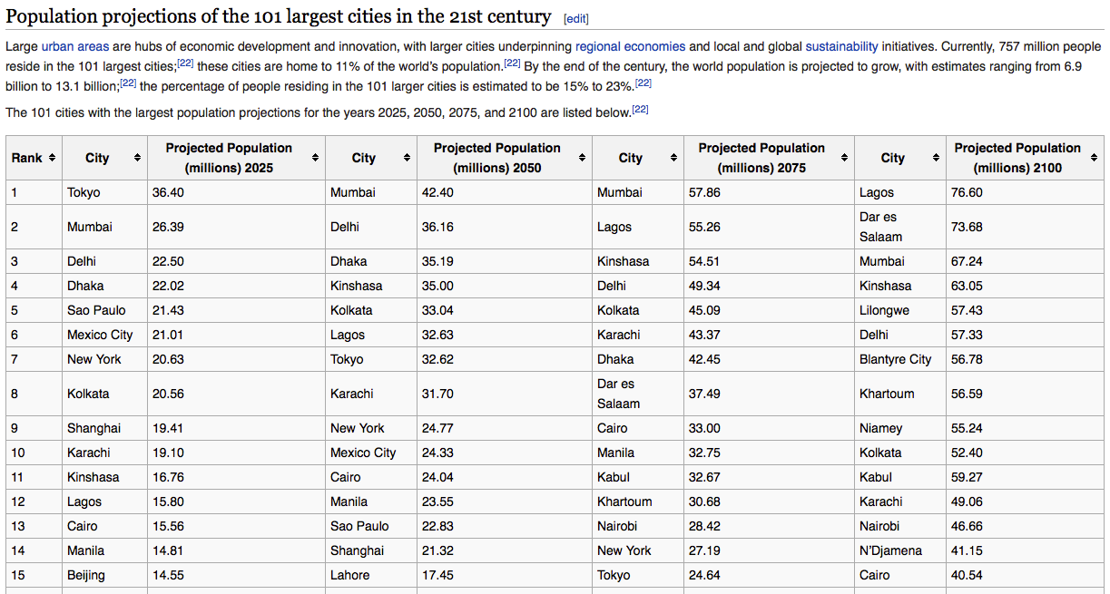
Gigacities
Largest Cities that ever existed in the next decades
Wikipedia
Hoornweg & Pope (2014).
Population predictions of the 101 largest cities in the 21st century
Compute the properties of these cities: their innovation rates, their speed of walking, their infrastructure needs and design, their wealth: They will be amazing !
Notes:
In the next few decades, some cities are projected to become larger than ever in history: this is expected to happen in South Asia, (Mumbai, Delhi), but also in Africa (Lagos, Kinshasa). These projections are mostly based on demographics and population growth decreases with urbanization. But if they hold Lagos, Nigeria may become the largest city in the world ever. Use our scaling results to imagine its diversity, wealth, inequality, skylines, and so on. The culture created in these cities is likely to come to dominate the 21st (and 22nd) century, much as NYC and Tokyo dominated the 20th, and Paris and London the 19th, and so on. It will be a very different world.

Slide 7
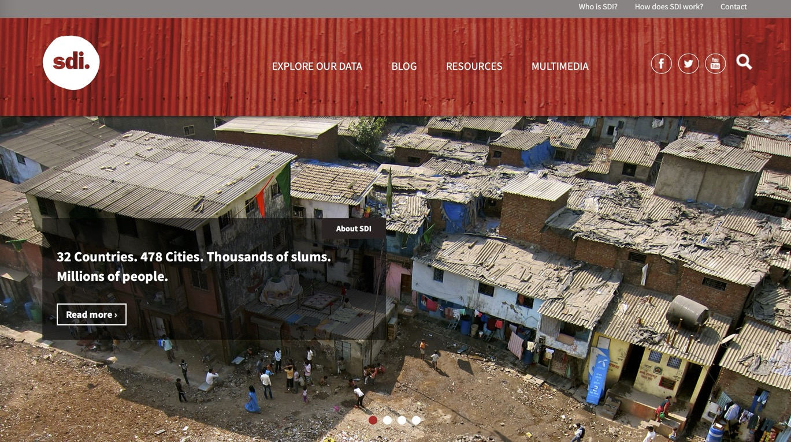
Fast Human Development in a Million Neighborhoods
The challenge of slums and accelerating the development of livable cities
Can you create a million great neighborhoods supporting a decent life in one generation?
Notes:
A challenge that goes along with it, is of inequality and slums in particular. In 2023, the number of people living in slums was revised up to 1.1 billion people, but this is now a smaller fraction of the world’s population. How to generate inclusion, prosperity, basic services and a dignified life for all is a major challenge ahead, but I hope you saw some reasons for hope when we discussed neighborhoods.

Slide 8
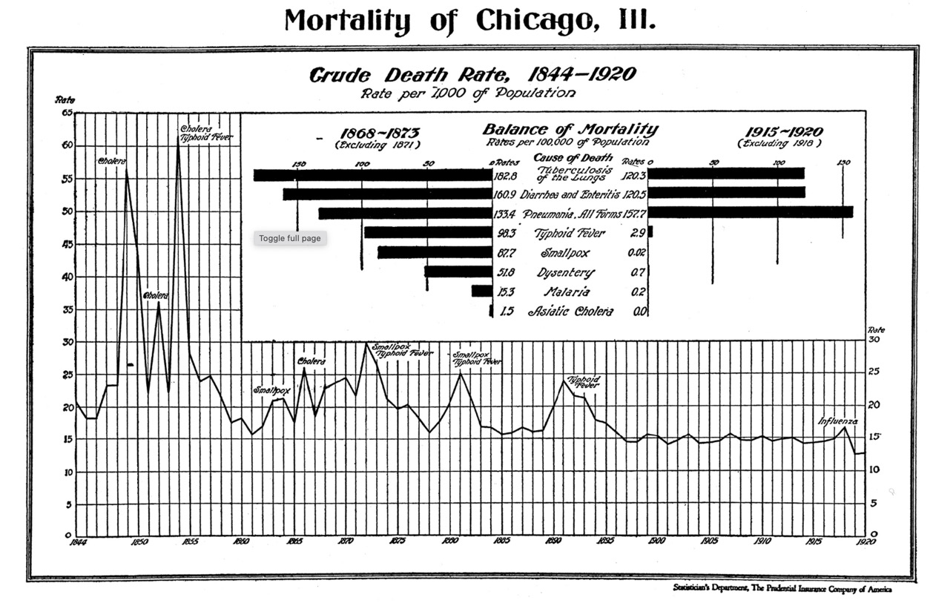
All cities are developing cities
Notes:
And here are some additional reasons for hope. Literally every city which is now rich was poor and had slums at some point. Chicago was awful, but all this was understood and solved, mostly with good science and capacity in government.

Slide 9
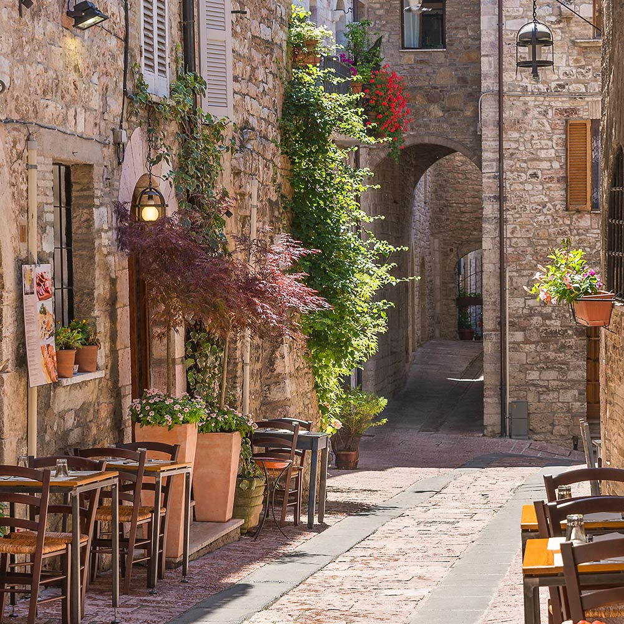
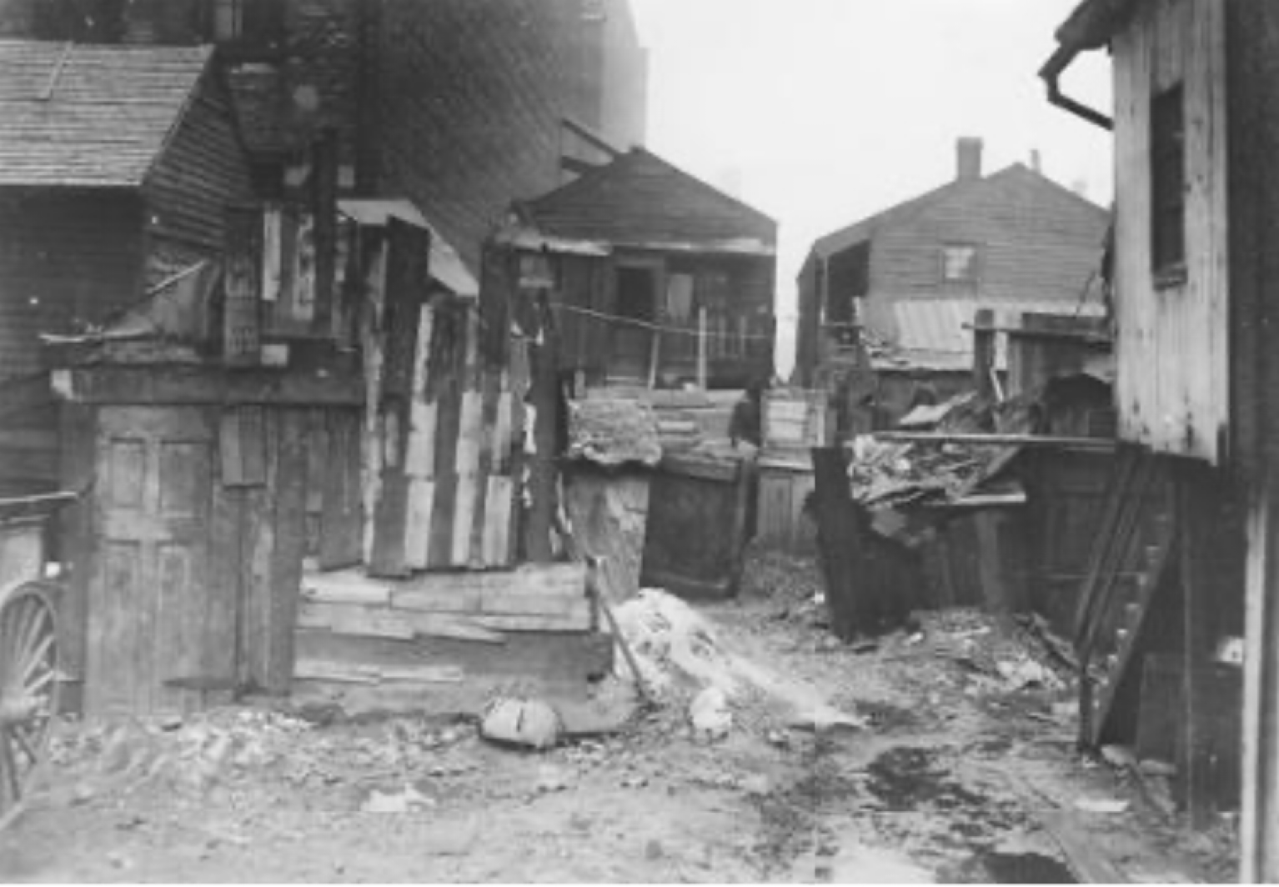

Chicago, Near West Side, 1910
visit
Toledo, Spain
http://www.encyclopedia.chicagohistory.org/pages/3796.html
https://www.ferrerhotels.com/travellost/en/most-beautiful-streets-of-spain/
Notes:
And now, the most beautiful streets in the world were once informal settlements. They preserve a human scale, charm that is almost impossible to design de novo. Understanding the evolution of cities and neighborhoods is therefore key, as we did in this course.

Slide 10
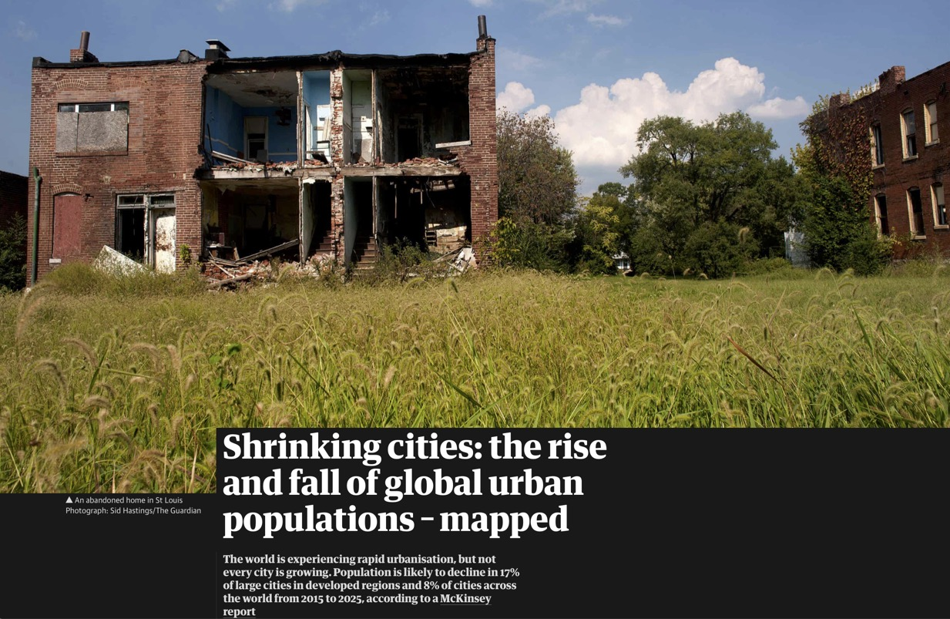
Shrinking Cities
a critical challenge for the US and many other richer nations, including China
https://www.theguardian.com/cities/gallery/2016/nov/02/global-population-decline-cities-mapped
infrastructure is hard to shrink and creates enormous deficits: can you imagine how to improve this situation?
Notes:
Another challenge, in other parts of the world, is decaying or shrinking cities. This is major and is likely coming to you if you live in a high income nation, unless we figure out how to better handle international migration.

Slide 11
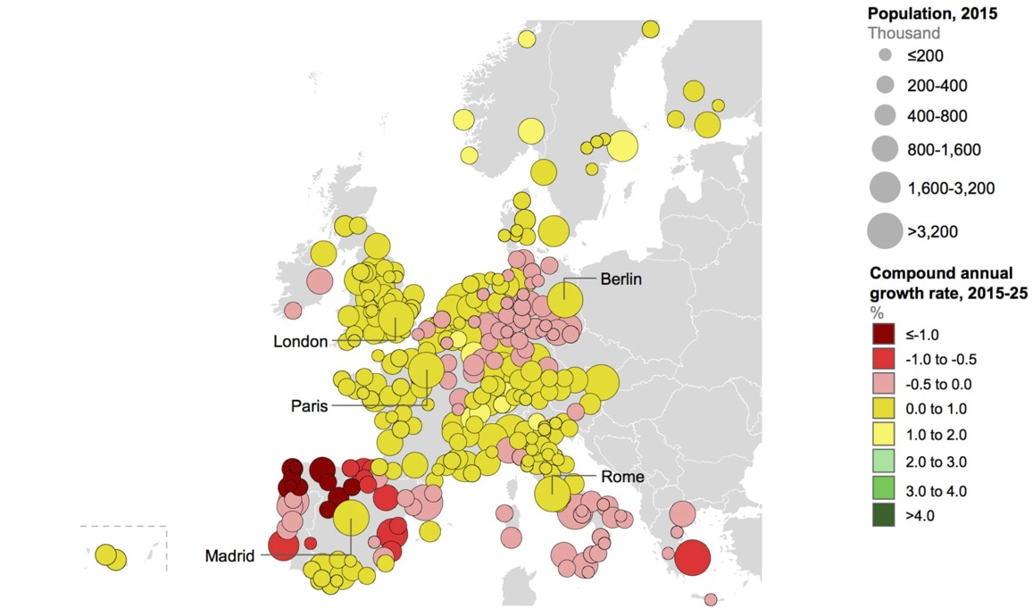
Shrinking Cities
The challenge of slums and accelerating the development of livable cities
infrastructure is hard to shrink and creates enormous stranded costs (and deficits): can you imagine how to improve this situation?
https://www.theguardian.com/cities/gallery/2016/nov/02/global-population-decline-cities-mapped
Notes:
Red and pink show shrinking cities (by population) in Europe. Dark yellow is on the verge.

Slide 12
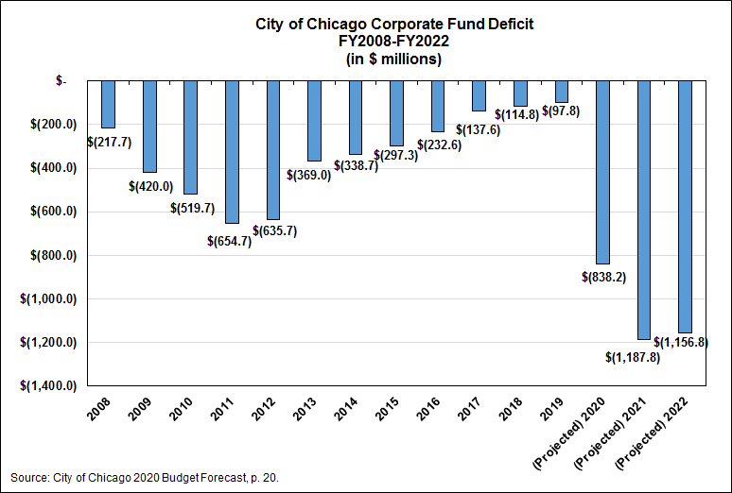
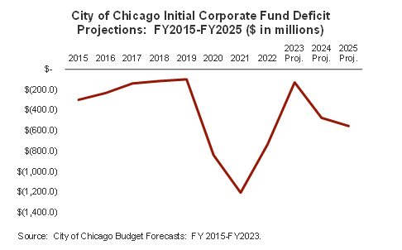
Short or long term recovery?
https://www.civicfed.org/civic-federation/blog/city-chicago-projected-budget-deficit-increases-8382-million
https://www.civicfed.org/civic-federation/blog/fy2023-chicago-budget-forecast-signals-short-term-recovery
Notes:
Here are some numbers for the city of Chicago in terms of funding

Slide 13
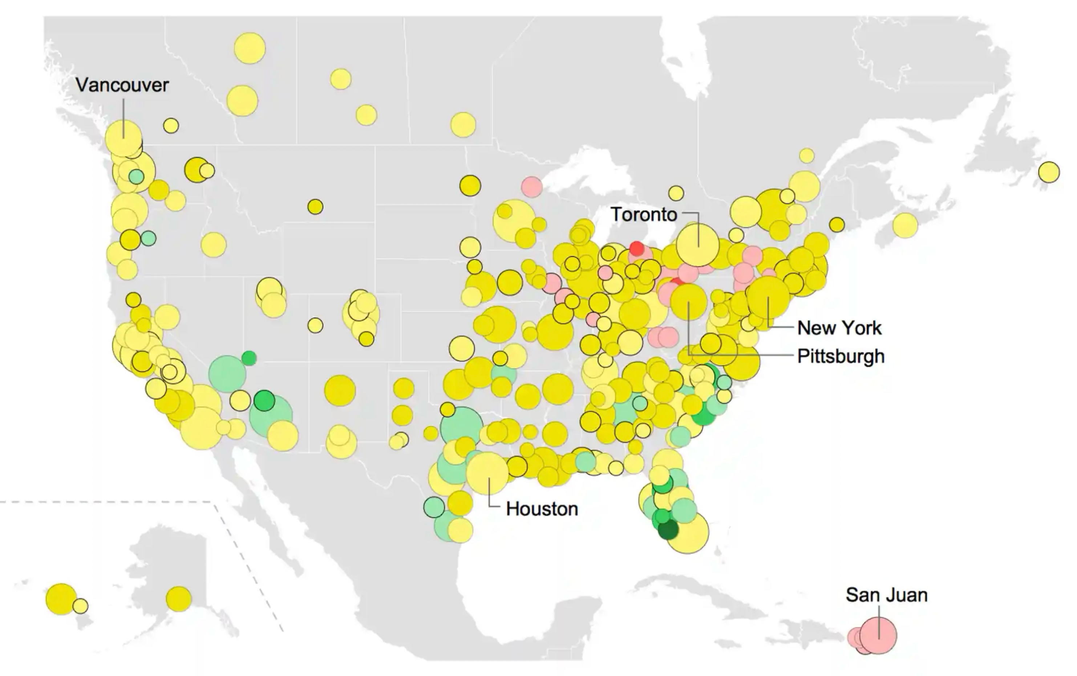
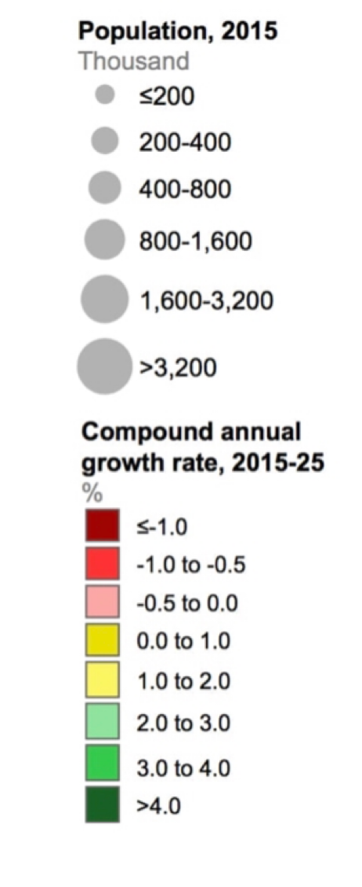
Notes:
And here is the corresponding map for North America. The midwest and Puerto Rico are the most affected places.

Slide 14
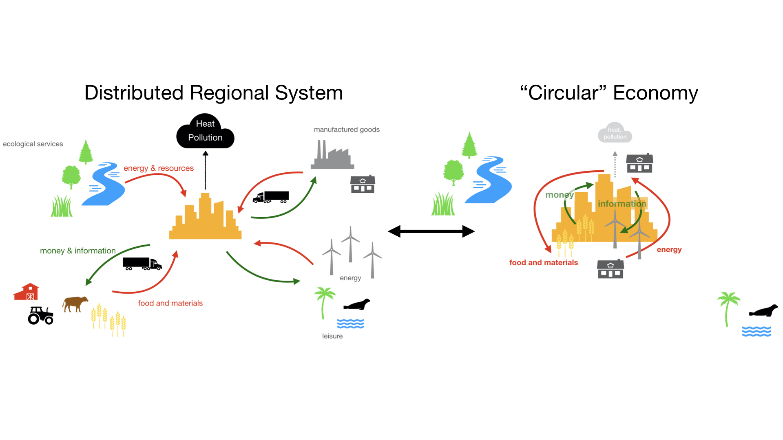
Decarbonization and Sustainability
Changing Humans relationship with Nature and the Planet
will change the structure of cities and urban systems: can you predict how?
Notes:
Finally, but in some sense the challenge of all challenges is the sustainability transition, including decarbonizing energy. Many ideas call for cities to internalize more and more of their energy and resource flows to save energy and reduce their external environmental impacts. What will happen to urban systems as that is done? What will happen to small towns?

Slide 15
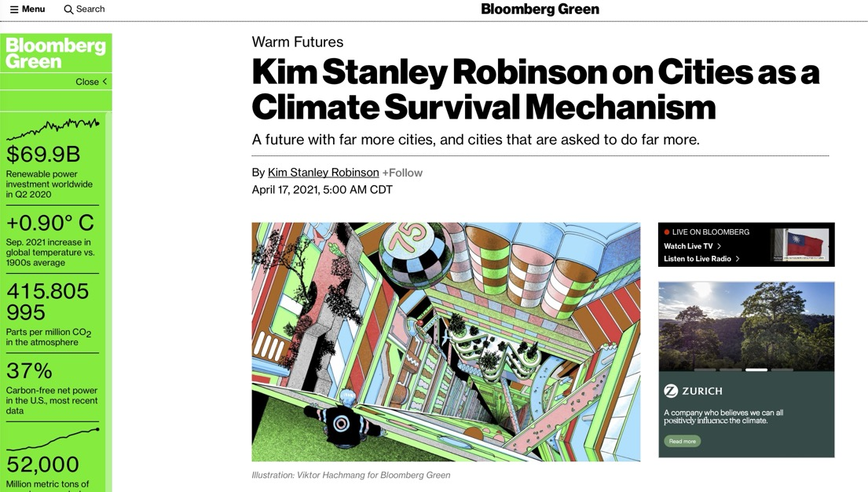
https://www.bloomberg.com/news/articles/2021-04-17/the-city-as-a-survival-mechanism-kim-stanley-robinson
Notes:
This is a nice piece about the need for cities in the face of our climate crisis.

Slide 16
Desert Sun
Energy from Crops
Wind Power
Northern Europe Sun
1,000
Qatar
Solar PV (10% efficiency, sunny locations)
Solar PV (10% efficiency, northern Europe)
Canada
USA
France
Germany
Singapore
Energy Use per Person ($kWh/d/p$)
Russia
Japan
100
South Africa
UK
Libya
Hong Kong
Brazil
China
Algeria
India
1 $W/{m^{2}}$
10
DR Congo
0.1 $W/{m^{2}}$
Bangladesh
10
100
1,000
10,000
Population Density ($people/km^{2}$)
Notes:
But cities will struggle to generate they energy from renewables locally, because they have such high energy densities. For this reason alone, large cities will have to continue to import some of their energy.

Slide 17


Notes:
The challenge of integrated sustainable development, summarized by the SDGs is well tailored for cities, which have in fact been leading efforts to attain them.

Slide 18
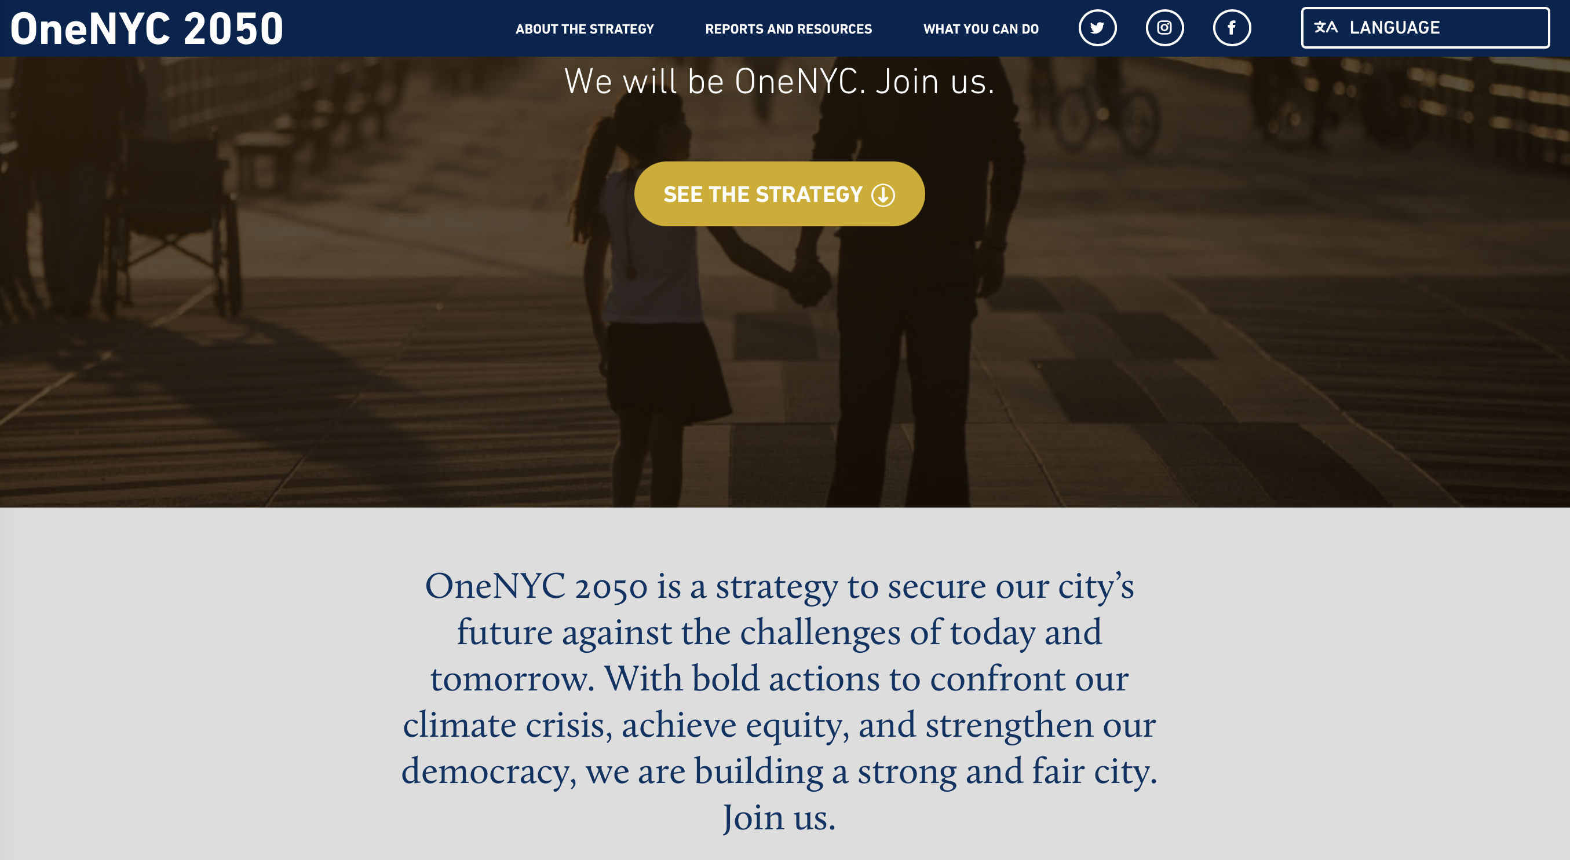
https://onenyc.cityofnewyork.us/
Notes:
Here’s NYC, which has been a world leader and has created interesting communication materials…

Slide 19
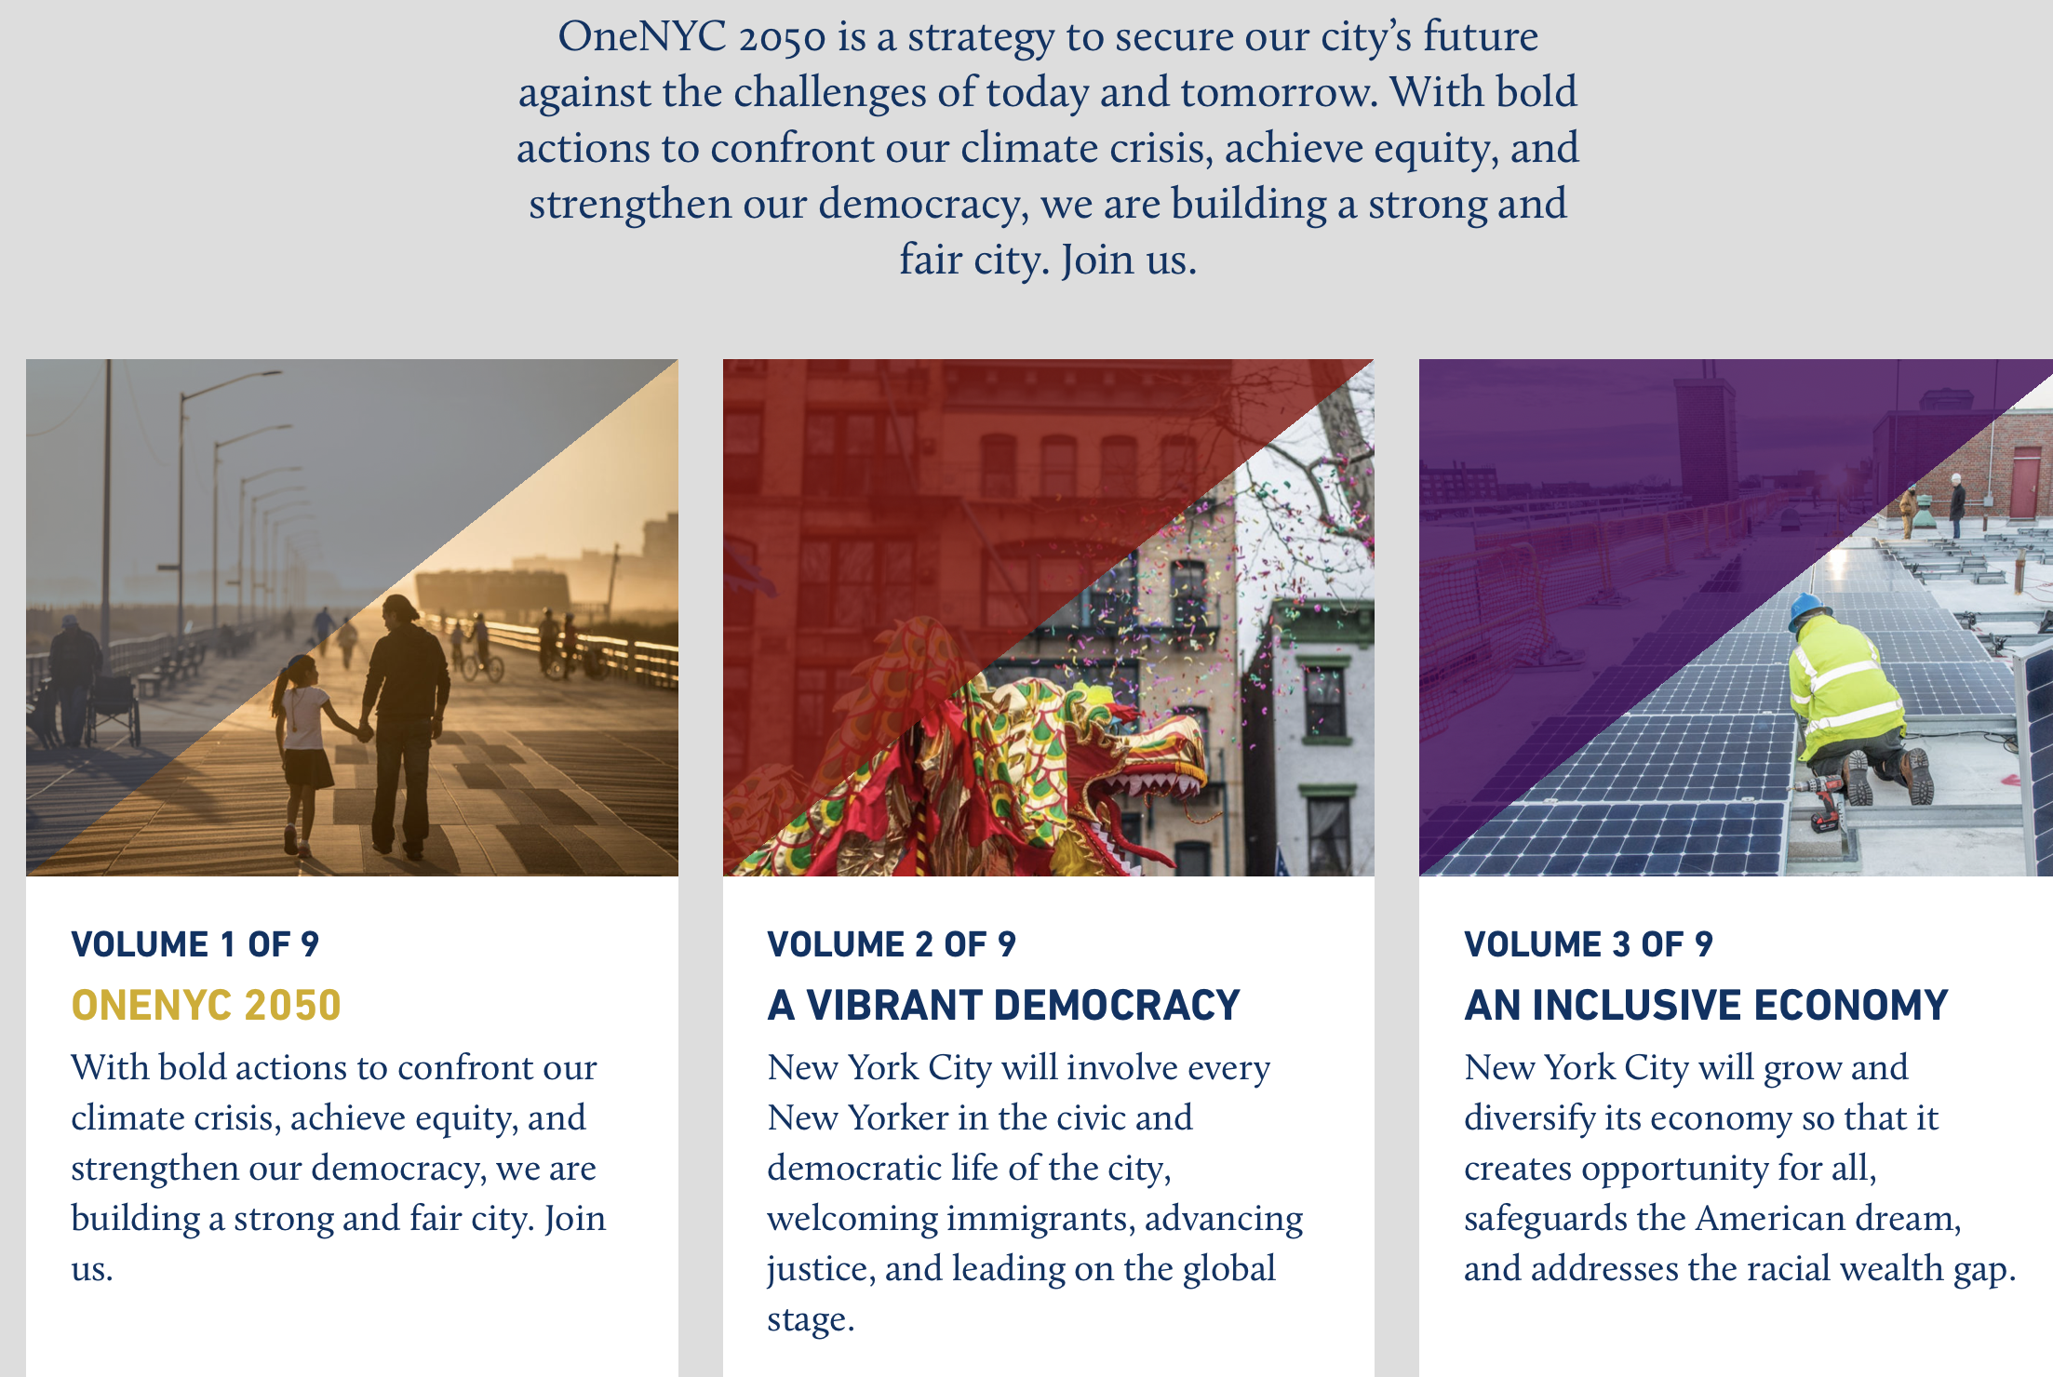
https://sdgs.un.org/sites/default/files/2020-09/International-Affairs-VLR-2019.pdf
https://onenyc.cityofnewyork.us/

Slide 20
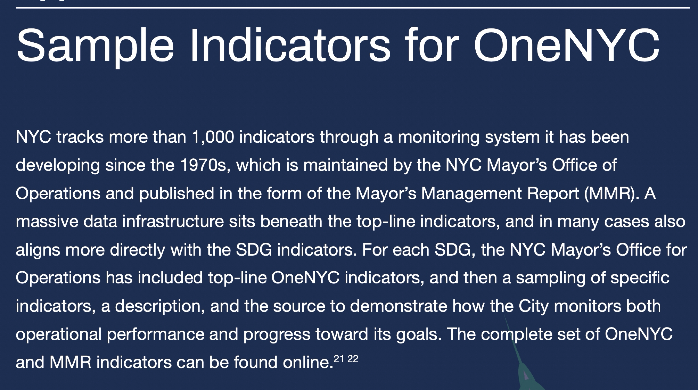
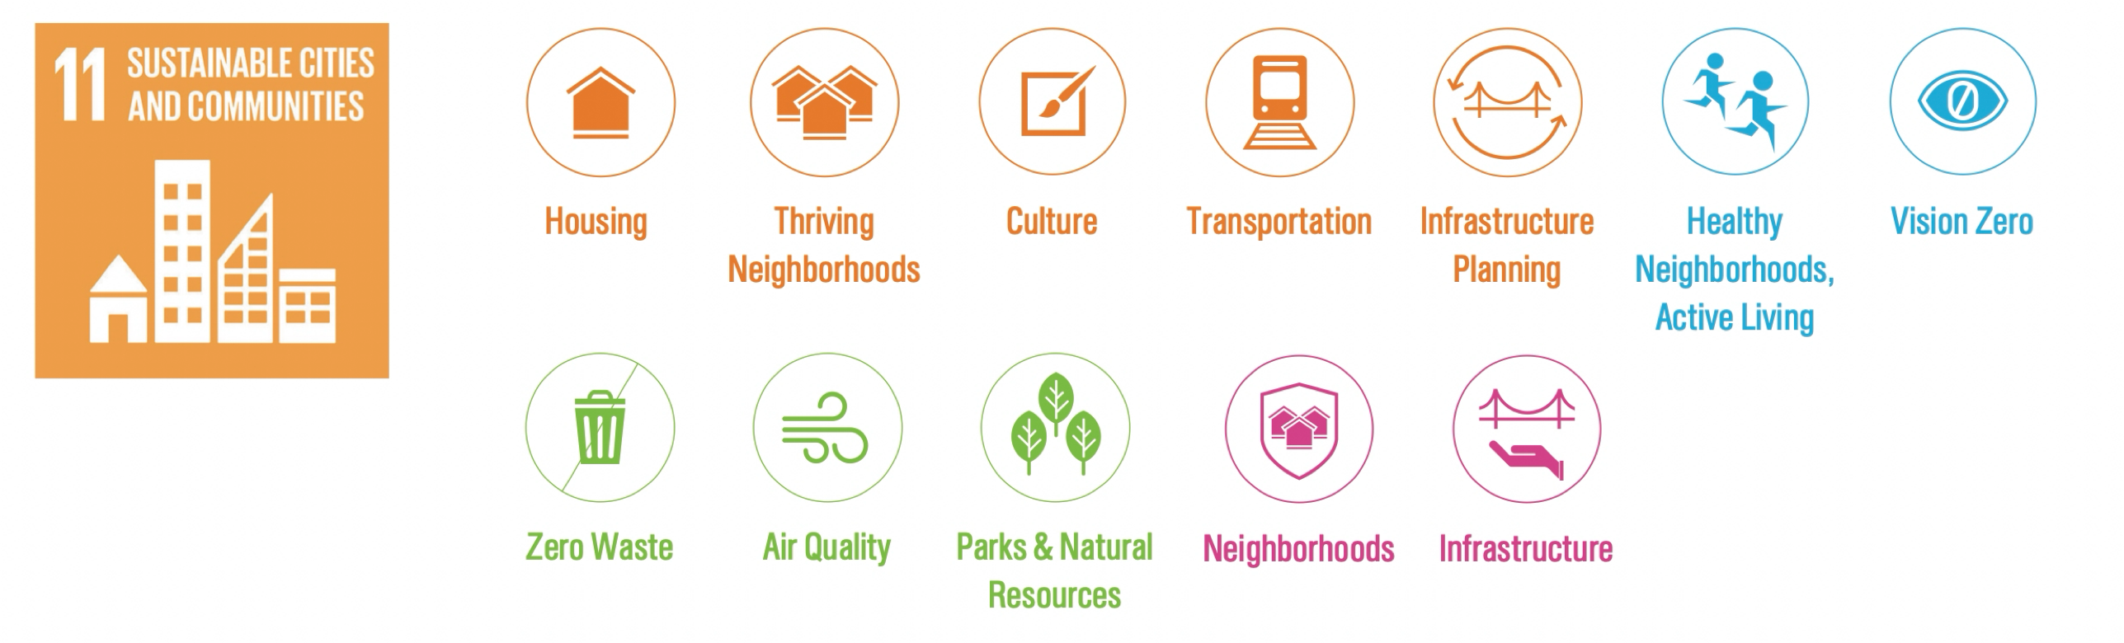
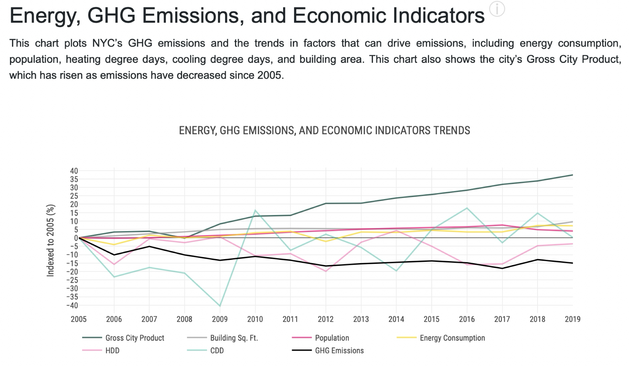
Holistic, Complex Systems approach to Goals and Policy
pioneered climate action plans
voluntary local reviews (UN Agenda 2030)
http://onenyc.cityofnewyork.us
Localizing Sustainable Development in Cities
Notes:
And the alignment of many city specific metrics with SDG objectives. Many other cities are adopting similar integrated approaches and metrics, and are likely to lead their national governments in attaining sustainable development.

Slide 21
New kind of policy
riding on urban processes revealed by science, with 20-30 year objectives and quantified metrics
Notes:
Note how this is a new kind of policy approach, encouraging large scale collaborations for the long term.

